Slide 1

TOPIC- Introduction to computer
COURSE: CCC Concept
CHAPTER: 01 (Introduction to computer)
DAY: 03
NIELIT
Presentation By : Shruti Dubey

Slide 2
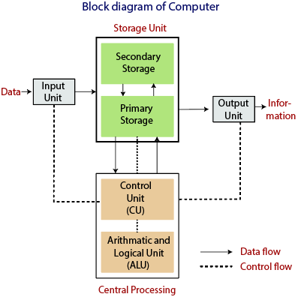
Central Processing Unit (CPU)

Slide 3
Functions of Computer
1) Inputting: It is the process of entering raw data, instructions and information into the computer. It is performed with the help of input devices.
2) Storing: The computer has primary memory and secondary storage to store data and instructions. It stores the data before sending it to CPU for processing and also stores the processed data before displaying it as output dling in Java – Java point
3) Processing: It is the process of converting the raw data into useful information. This process is performed by the CPU of the computer. It takes the raw data from storage, processes it and then sends back the processed data to storage.
4) Outputting: It is the process of presenting the processed data through output devices like monitor, printer and speakers.
5) Controlling: This operation is performed by the control unit that is part of CPU. The control unit ensures that all basic operations are executed in a right manner and sequence.

Slide 4
Uses of Computer
Business
Education
Healthcare
Retail and Trade
Government
Marketing
Science
Publishing
Arts and Entertainment
Communication
Banking and Finance
Transport
Navigation
Working From Home
Military
Social
Booking Vacations
Security and Surveillance
Weather Forecasting
Robotics
व्यापार
शिक्षा
स्वास्थ्य देखभाल
खुदरा और व्यापार
सरकार
विपणन
विज्ञान
प्रकाशन
कला और मनोरंजन
संचार
बैंकिंग व वित्त
ट्रांसपोर्ट
पथ प्रदर्शन
घर से काम करना
सैन्य
सामाजिक
बुकिंग की छुट्टियां
सुरक्षा और निगरानी
मौसम की भविष्यवाणी
रोबोटिक

Slide 5
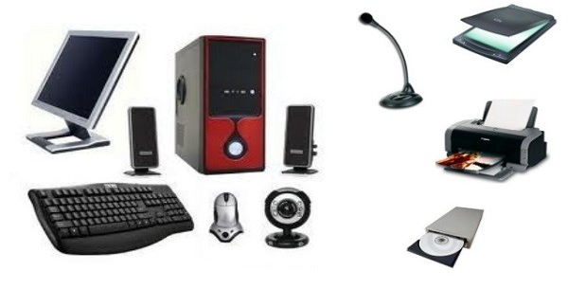
Hardware
Computer Hardware
Quite simply, computer hardware is the physical components that a computer system requires to function. It encompasses everything with a circuit board that operates within a PC or laptop; including the motherboard, graphics card, CPU (Central Processing Unit), ventilation fans, webcam, power supply, and so on.

Slide 6
Basics of Hardware and Software
Central Processing Unit (CPU)
Input Device
Output Device

Slide 7
Central Processing Unit (CPU)

Slide 8
Central Processing Unit (CPU)
The central processing unit (CPU) or processor, is the unit which performs most of the processing inside a computer. It processes all instructions received by software running on the PC and by other hardware components, and acts as a powerful calculator.
The CPU is placed into a specific square-shaped socket found on all motherboards by inserting its metallic connectors or pins found on the underside. Each socket is built with a specific pin layout to support only a specific type of processor.
Since modern CPUs produce a lot of heat and are prone to overheating, they must be kept cool with appropriate fans or ventilation systems, and covered with heat sinks and thermal paste.
To control instructions and data flow to and from other parts of the computer, the CPU relies heavily on a chipset, which is a group of microchips located on the motherboard.

Slide 9
Input Devices
Keyboard
Mouse
Joy Stick
Light pen
Scanner
Graphic Tablet
Microphone
Magnetic Ink Car Reader(MICR)
Optical Character Reader(OCR)
Bar Code Reader
Optical Mark Reader(OMR)
Webcam
Biometric Devices
An Input device can send data to another device, but it cannot receive data from another device. Examples of input devices include the following.

Slide 10
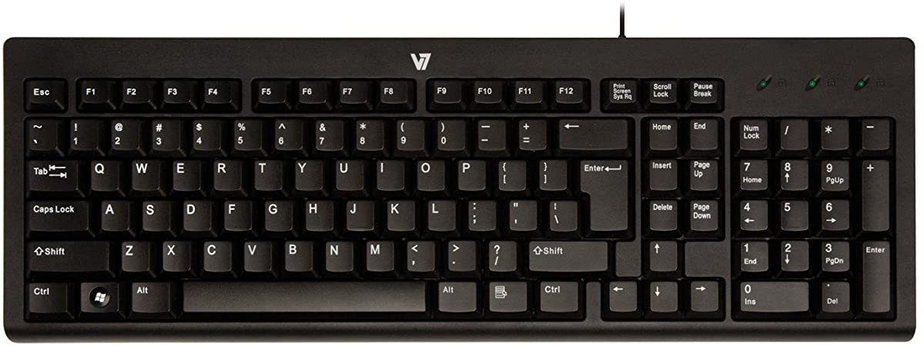
Keyboard
Keyboard is the most common and very popular input device which helps to input data to the computer. The layout of the keyboard is like that of traditional typewriter, although there are some additional keys provided for performing additional functions.
Keyboards are of two sizes 84 keys or 101/102 keys, but now keyboards with 104 keys or 108 keys are also available for Windows and Internet.

Slide 11
Keyboard
1 | Typing Keys These keys include the letter keys (A-Z) and digit keys (09) which generally give the same layout as that of typewriters.
2 | Numeric Keypad It is used to enter the numeric data or cursor movement. Generally, it consists of a set of 17 keys that are laid out in the same configuration used by most adding machines and calculators.
3 | Function Keys The twelve function keys are present on the keyboard which are arranged in a row at the top of the keyboard. Each function key has a unique meaning and is used for some specific purpose.
4 | Control keys These keys provide cursor and screen control. It includes four directional arrow keys. Control keys also include Home, End, Insert, Delete, Page Up, Page Down, Control(Ctrl), Alternate(Alt), Escape(Esc).
5 | Special Purpose Keys Keyboard also contains some special purpose keys such as Enter, Shift, Caps Lock, Num Lock, Space bar, Tab, and Print Screen.

Slide 12
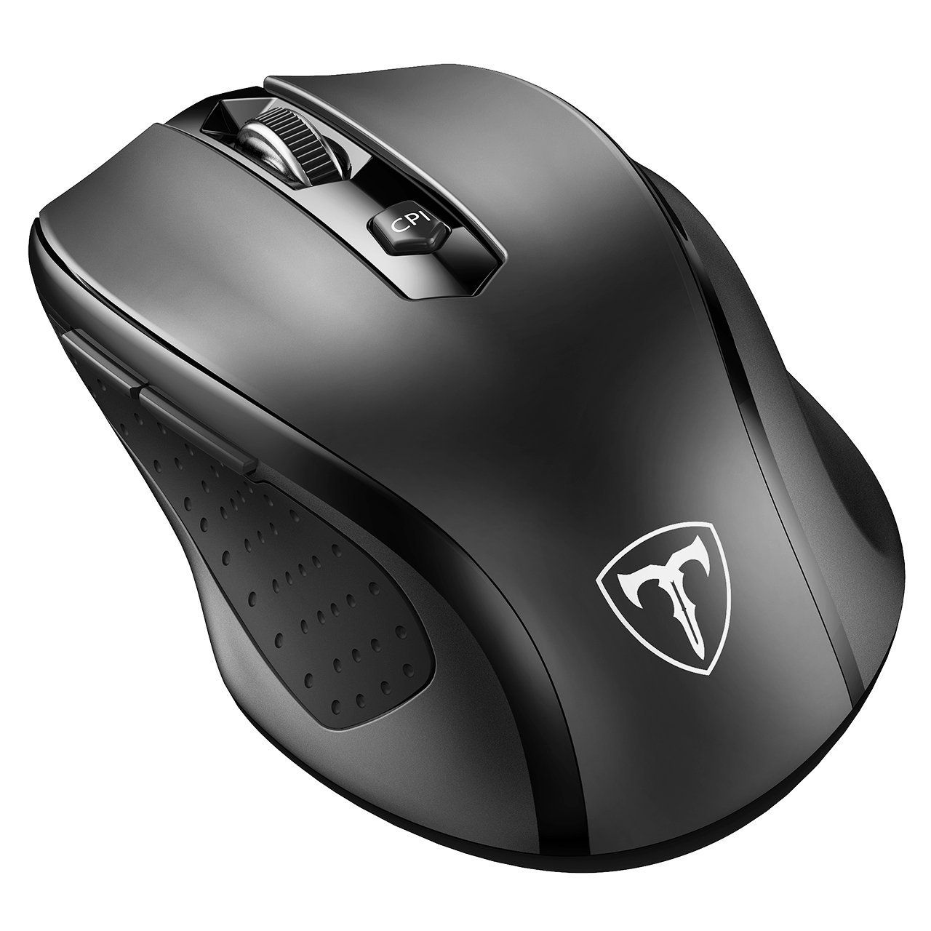
Mouse
A computer mouse is an input device that is used with a computer. Moving a mouse along a flat surface can move the cursor to different items on the screen. Items can be moved or selected by pressing the mouse buttons (called clicking).
Mouse is the most popular pointing device. It is a very famous cursor-control device having a small palm size box with a round ball at its base, which senses the movement of the mouse and sends corresponding signals to the CPU when the mouse buttons are pressed.
Generally, it has two buttons called the left and the right button and a wheel is present between the buttons. A mouse can be used to control the position of the cursor on the screen, but it cannot be used to enter text into the computer.

Slide 13
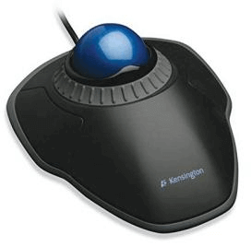
Common types of the mouse:
Trackball Mouse:
It is a stationary input device that has ball mechanism to move the pointer or cursor on the screen. The ball is half inserted in the device and can be easily rolled with finger, thumb or the palm to move the pointer on the screen. The device has sensor to detect the rotation of ball. It remains stationary; you don't need to move it on the operating surface. So, it is an ideal device if you have limited desk space as you don't need to move it like a mouse.

Slide 14
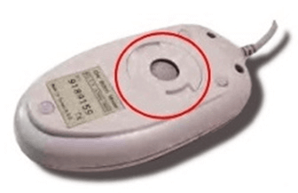
Mechanical Mouse:
Mechanical Mouse:
It has a system of a ball and several rollers to track its movement. It is a corded type of mouse. A mechanical mouse can be used for high performance. The drawback is that they tend to get dust into the mechanics and thus require regular cleaning.

Slide 15
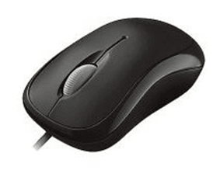
Optical Mouse:
An optical mouse uses optical electronics to track its movement. It is more reliable than a mechanical mouse and also requires less maintenance. However, its performance is affected by the surface on which it is operated. Plain non-glossy mouse mat should be used for best results. The rough surface may cause problems for the optical recognition system, and the glossy surface may reflect the light wrongly and thus may cause tracking issues.

Slide 16
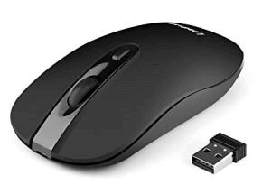
Cordless or Wireless Mouse:
As the name suggests, this type of mouse lacks cable and uses wireless technology such as IrDA (infrared) or radio (Bluetooth or Wi-Fi) to control the movement of the cursor. It is used to improve the experience of using a mouse. It uses batteries for its power supply

Slide 17
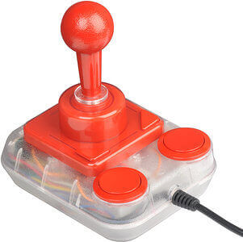
Joy Stick
A joystick is also a pointing input device like a mouse. It is made up of a stick with a spherical base. The base is fitted in a socket that allows free movement of the stick. The movement of stick controls the cursor or pointer on the screen.
The frist joystick was invented by C. B. Mirick at the U.S. Naval Research Laboratory. A joystick can be of different types such as displacement joysticks, finger-operated joysticks, hand operated, isometric joystick, and more. In joystick, the cursor keeps moving in the direction of the joystick unless it is upright, whereas, in mouse, the cursor moves only when the mouse moves.

Slide 18
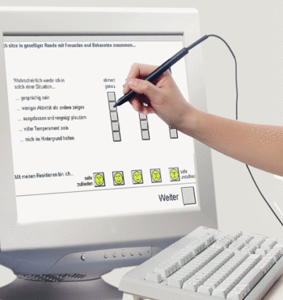
Light pen
A light pen is a computer input device that looks like a pen. The tip of the light pen contains a light-sensitive detector that enables the user to point to or select objects on the display screen. Its light sensitive tip detects the object location and sends the corresponding signals to the CPU. It is not compatible with LCD screens, so it is not in use today. It also helps you draw on the screen if needed. The first light pen was invented around 1955 as a part of the Whirlwind project at the Massachusetts Institute of Technology (MIT).

Slide 19
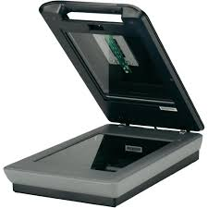
Scanner
The scanner uses the pictures and pages of text as input. It scans the picture or a document. The scanned picture or document then converted into a digital format or file and is displayed on the screen as an output. It uses optical character recognition techniques to convert images into digital ones. Some of the common types of scanners are as follows:

Slide 20
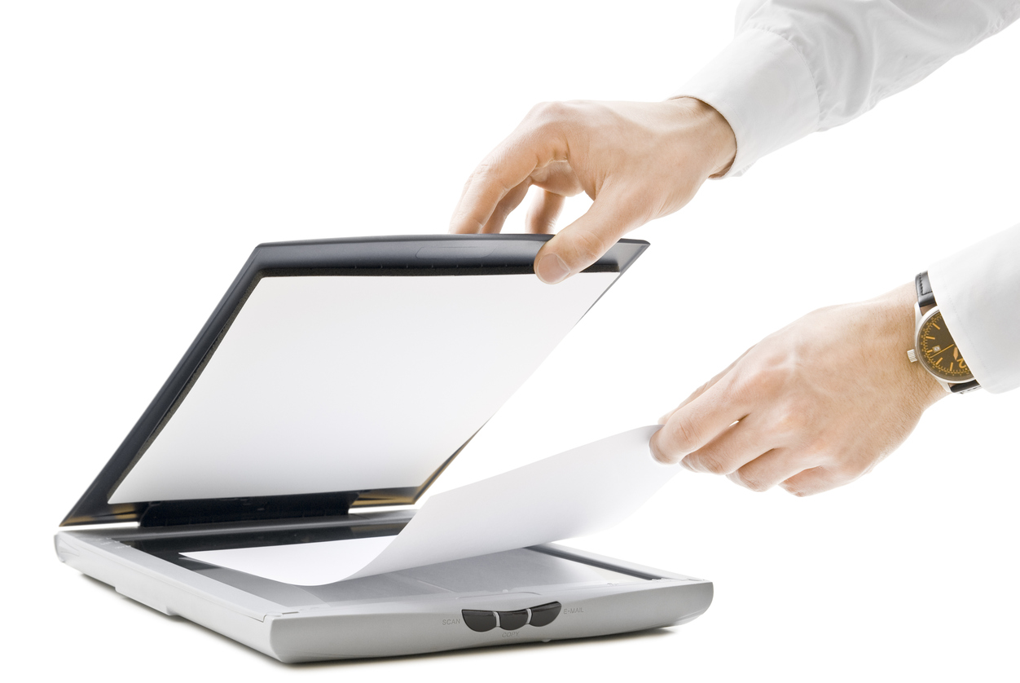
Some of the common types of scanners are as follows:
Flatbed scanner
A flatbed scanner is an optical scanner which makes use of a flat surface for scanning documents. The scanner is capable of capturing all elements on the document and does not require movement of the document.

Slide 21
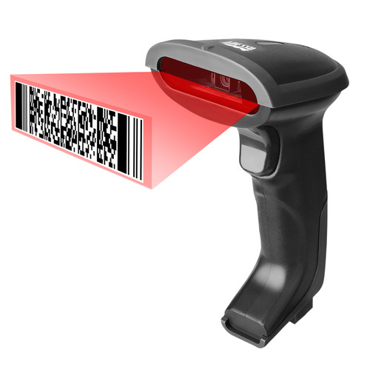
Handheld Scanner:(Bar code scanner)
A barcode reader is an optical scanner that can read printed barcodes, decode the data contained in the barcode and send the data to a computer. Like a flatbed scanner, it consists of a light source, a lens and a light sensor for translating optical impulses into electrical signals
It is a small manual scanning device which is held by hand and is rolled over a flat image that is to be scanned. The drawback in using this device is that the hand should be steady while scanning; otherwise, it may distort the image. One of the commonly used handheld scanners is the barcode scanner which you would have seen in shopping stores.

Slide 22
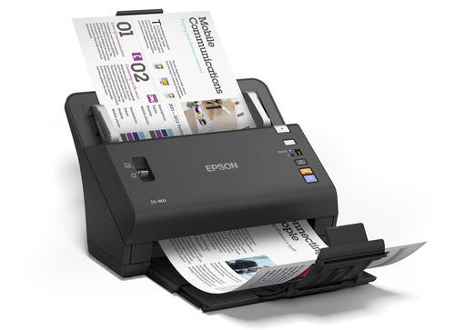
Sheet fed Scanner:
In this scanner, the document is inserted into the slot provided in the scanner. The main components of this scanner include the sheet-feeder, scanning module, and calibration sheet. The light does not move in this scanner. Instead, the document moves through the scanner. It is suitable for scanning single page documents, not for thick objects like books, magazines, etc.

Slide 23
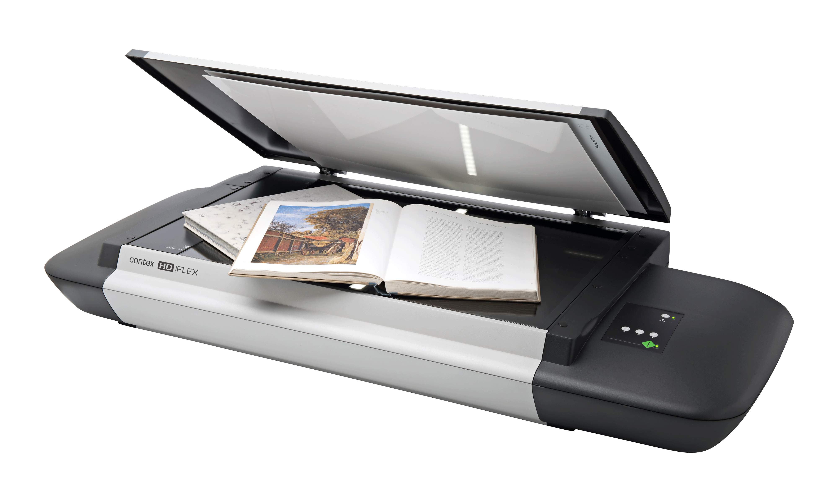
Drum Scanner:
The drum scanner was the first image scanner designed for use with a computer. 'At the time of its creation in 1957 by the US National Bureau of Standards, the first scan had a resolution of 176 pixels for the long dimension.

Slide 24
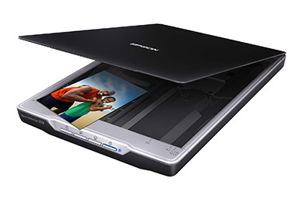
Photo Scanner:
It is designed to scan photographs. It has high resolution and color depth, which are required for scanning photographs. Some photo scanners come with in-built software for cleaning and restoring old photographs.

Slide 25
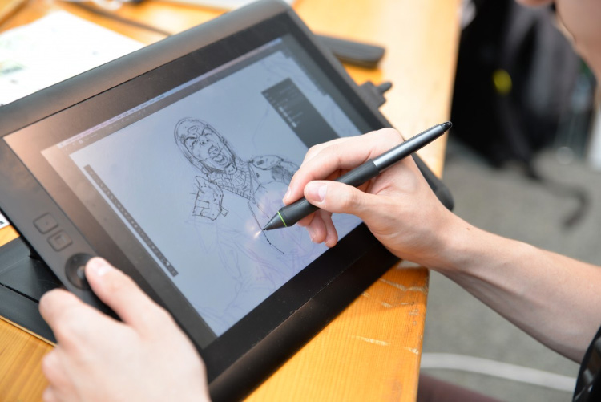
Graphic Tablet
A graphics tablet is a computer input device that enables a user to hand-draw images, animations and graphics, with a special pen-like stylus, similar to the way a person draws images with a pencil and paper. These tablets may also be used to capture data or handwritten signatures

Slide 26
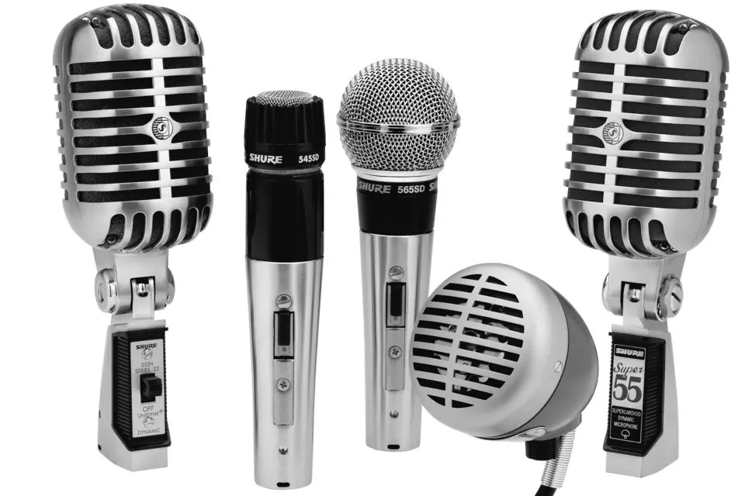
Microphone
The microphone is a computer input device that is used to input the sound. It receives the sound vibrations and converts them into audio signals or sends to a recording medium. The audio signals are converted into digital data and stored in the computer. The microphone also enables the user to telecommunicate with others. It is also used to add sound to presentations and with webcams for video conferencing. A microphone can capture audio waves in different ways.

Slide 27
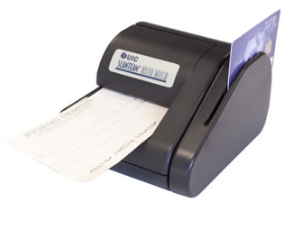
Magnetic Ink Car Reader(MICR)
MICR computer input device is designed to read the text printed with magnetic ink. MICR is a character recognition technology that makes use of special magnetized ink which is sensitive to magnetic fields. It is widely used in banks to process the cheques and other organizations where security is a major concern. It can process three hundred cheques in a minute with hundred-percent accuracy. The details on the bottom of the cheque (MICR No.) are written with magnetic ink. A laser printer with MICR toner can be used to print the magnetic ink.
The device reads the details and sends to a computer for processing. A document printed in magnetic ink is required to pass through a machine which magnetizes the ink, and the magnetic information is then translated into characters.
Magnetic ink character recognition

Slide 28
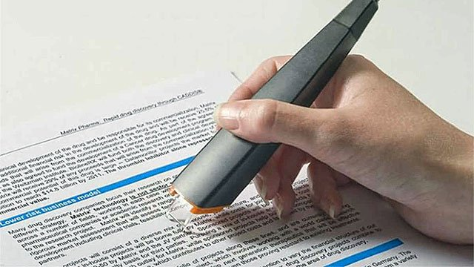
Optical Character Reader(OCR)
OCR computer input device is designed to convert the scanned images of handwritten, typed or printed text into digital text. It is widely used in offices and libraries to convert documents and books into electronic files.
It processes and copies the physical form of a document using a scanner. After copying the documents, the OCR software converts the documents into a two-color (black and white), version called bitmap. Then it is analyzed for light and dark areas, where the dark areas are selected as characters, and the light area is identified as background. It is widely used to convert hard copy legal or historic documents into PDFs. The converted documents can be edited if required like we edit documents created in ms word.

Slide 29
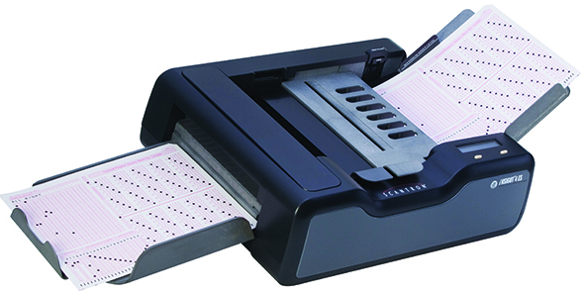
Optical Mark Reader(OMR)
Optical mark recognition is the process of reading information that people mark on surveys, tests and other paper documents. OMR is used to read questionnaires, multiple choice examination papers in the form of shaded areas

Slide 30
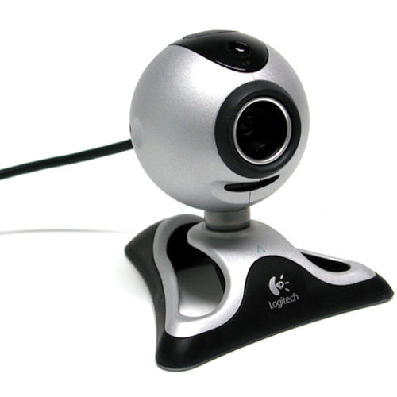
Webcam
Any camera which is connected to a computer is called a webcam. The in-built camera provided on a computer can also be considered a webcam. It is an input device as it can take pictures, and can be used to record videos if required. The pictures and videos are stored in the computer memory and can be displayed on the screen if required. Although it works almost the same as the digital camera, it is different from a digital camera, as it is designed to take compact digital photos that can be uploaded easily on the webpages and shared with others through the internet.

Slide 31
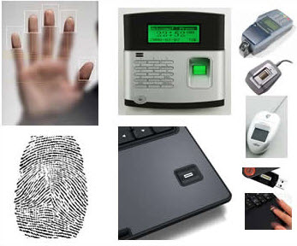
Biometric Devices
Biometrics refers to a process in which a person is identified through his or her biological features such as fingerprints, eye cornea, face structure, etc. It is done by using biometric devices, which can be of different types based on their scanning features and abilities, such as:
Face Scanner
Hand Scanner
Fingerprint Scanner
Retina or Iris Scanner
Voice Scanner

Slide 32
Software
Software, which is abbreviated as SW or S/W, is a set of programs that enables the hardware to perform a specific task. All the programs that run the computer are software.
The software can be of three types: System software, Application software, and Programming software.

Slide 33
Thank You
NIELIT
Presentation By : Shruti Dubey

